Slide 1


Tutorial

Slide 2


Introduction
DEMO TIME
Sit back & relax
https://www.youtube.com/watch?v=by40aaCbLpY

Slide 3
Assignment / Tutorial components
Text generation
Speech generation
Gestures generation
Resulting in a full conversation (text, speech and gestures) generated by Machine Learning.
Note: Time is short - we will not code or train AI models.

Slide 4



Slide 6

Section Title

Slide 7

Section Title

Slide 8

Gesture Generation

Slide 9
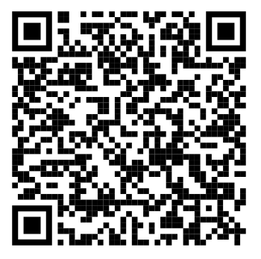
Text Generation
Step 1 : Use public LLMs to create your story
Step 2 : Create your characters and dialogues
Step 3 : Explore the limitations of LLMs
Complete in your browser using
OpenAI
Open-source LLMs
Tutorial
Tutorial : https://github.com/anvarava/wasp-2023-summer-school/blob/main-2/subsystem1_text-generation.md

Slide 10
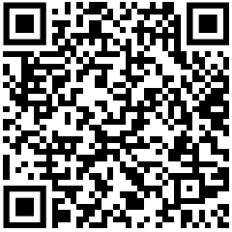
Speech Generation
Step 1 : Run speech synthesis model in Colab
Step 2 : Multiple sentence synthesis per speaker
Step 3 : Change speaker and change speaking rate
Tutorial
Completed using
Google Colab
Tutorial : https://github.com/Svito-zar/wasp-2023-summer-school/tree/main/subsystem2_text-to-speech

Slide 11
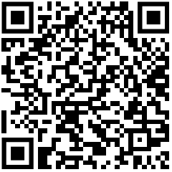
Gesture Generation
Step 1 : Motion generation
Step 2 : Motion visualisation
Step 3 : Export FBX
Completed using
a WASP web server
a local web server
Docker CLI
Tutorial
Tutorial : https://github.com/Svito-zar/wasp-2023-summer-school/tree/main/subsystem3_gesture-generation

Slide 12

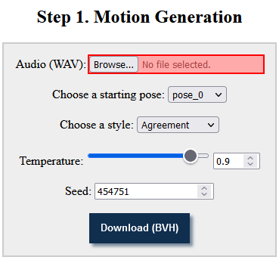
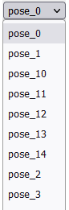
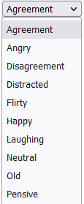
Gesture Generation : 1. Motion generation
Audio (.wav)
→ ZeroEGGS
→ Motion (.bvh)
Controls
19 styles
15 starting poses
Temperature
Seed
ZeroEGGS repo
ZeroEGGS (Saeed Ghorbani @ Ubisoft LaForge) : https://github.com/ubisoft/ubisoft-laforge-ZeroEGGS

Slide 13

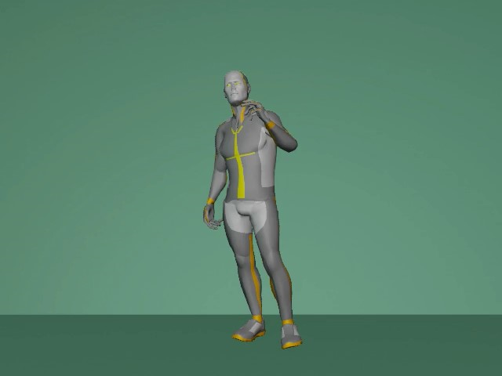
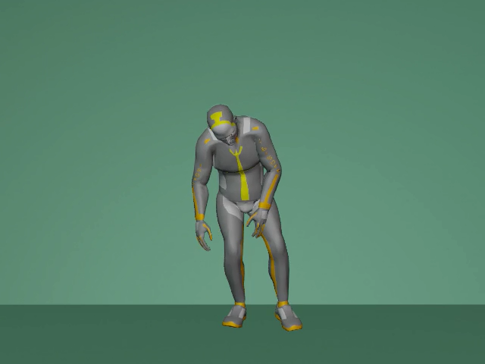
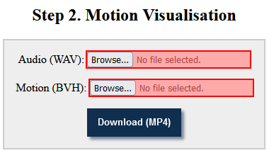
Gesture Generation : 2. Motion visualisation
Audio (.wav) + Motion (.bvh)
→ GENEA Challenge visualiser
→ Video (.mp4)
Visualiser
The GENEA Challenge visualiser (2023) : https://github.com/TeoNikolov/genea_visualizer/

Slide 14
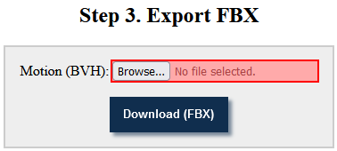
Gesture Generation : 3. Export FBX
Motion (.bvh)
→ GENEA Challenge visualiser
→ Motion (.fbx)
Visualiser
The GENEA Challenge visualiser (2023) : https://github.com/TeoNikolov/genea_visualizer/

Slide 15

Gesture Generation : Servers
Production server - http://129.192.81.237/
Recommended
Stable
Faster
Development server - http://129.192.83.172/
Backup plan
Uncertain availability
Local setup / Docker CLI - http://localhost/
Server repo
Tutorial
Gesture generation server (WASP SS 2023) : https://github.com/TeoNikolov/wasp-ss2023-gesgen

Slide 16
Teams
Splits
Teams of 4-5 students
Maximum 6-7 teams
Pick a cool team name
Have at least 1 computer
No ARM-based CPU
When ready
Tell us your team name
We give you a team ID
Teams
#1 - Algorithmic Amigos
#2 - VR WASP Wizards
#3 - Artificial Four
#4 - Quebec
#5 - Lucasfilm Ltd TM

Slide 17
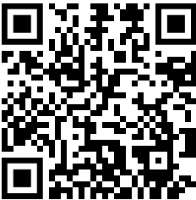
Assignment Agenda
Monday 15:30 - Presentation of assignment
Tuesday 14:00 - 16:00 - Work on text generation tutorial
Wednesday 10:00 - 12:00 - Work on text to speech tutorial
Wednesday 14:20 - 16:00 - Work on gesture generation tutorial
Wednesday 16:00 - 17:00 - Work on the tutorials
Thursday 09:00 - 12:00 - Work on final assignment
Thursday 12:00 - Submission deadline
Friday 09:00 - 12:00 - Demo of your submissions in the 3D dome
Rooms:
floor 1 - Eckerberg
floor 5 - Workshop area (Visualization Center)
Tuesday 14-16 ; Thursday 9-12
Assignment repo
Assignment repo : https://github.com/Svito-zar/wasp-2023-summer-school/

Slide 18
Submission
Full details available in the repo
Make sure to check again on Thursday morning
In case of changes…
Submit to tnikolov@hotmail.com OR tsakovm@gmail.com
In case of issues, reach out on Slack (or email):
Teodor Nikolov
Mihail Tsakov
Assignment repo
Assignment repo : https://github.com/Svito-zar/wasp-2023-summer-school/

Slide 19

Section Title

Slide 20

Section Title

Slide 21

Section Title

Slide 22


A few shapes
5.5
Billion
5.5
Billion
Text1
Text 2
Text 1
Text 2

